Slide 1
CIMMYT operated research facilities at Kiboko
Main farm (~3ha)
Established: 1984
New site (~45.6 ha)
Established: 2008
DH (20.3 Ha)
Established: 2012
IMAS CFT (~2ha)
Established: 2016

Slide 2
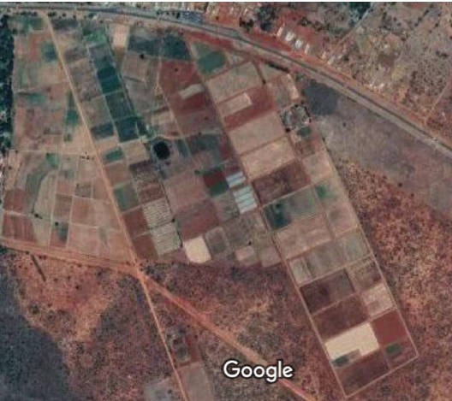

New Site (NS)
Drought screening: 9 ha
Low Nitrogen plots: 3 ha
Nurseries: 10 ha
Optimum trials:10 ha
Total blocks: 26
11 of 1 ha
11 of 2 ha
Others are blocks with :2 ha or less than 1 ha
DT FIELD
Low N
DT FIELD
DT FIELD
DT FIELD
Low N

Slide 3
DH facility map
1
12
2
3
11
10
4
5
9
8
6
7

